Slide 1

Deloitte/BT Quant Competition
Sebastian Coroian

Slide 2







Tool Suite

Slide 3
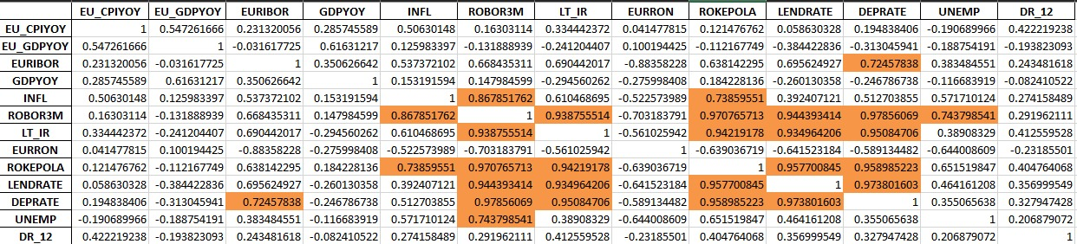
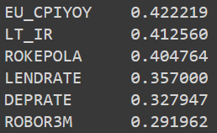
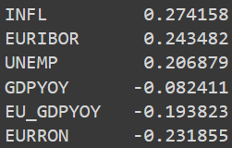
Correlation Matrix
Correlations with ‘DR_12’:

Slide 4
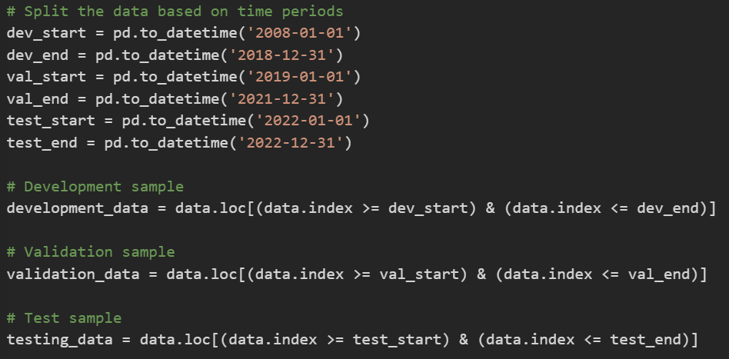
Data Splitting
Data was split into 3 samples, according to the instructions:
Development sample: 2008 – 2018
Validation sample: 2019 – 2021
Test sample: year 2022
These samples were used into training, validating and predicting each of the 3 models.

Slide 5
General Overview of the models & findings
Model | Model Type | RMSE
Model #1 | Multiple linear regression (MLR) | 0.0218197100755919
Model #2 | Random Forest Regression | 0.0132858153597993
Model #3 | Seasonal Auto-Regressive Integrated Moving Average with eXogenous factors (SARIMAX) | 0.0016802358001827

Slide 6
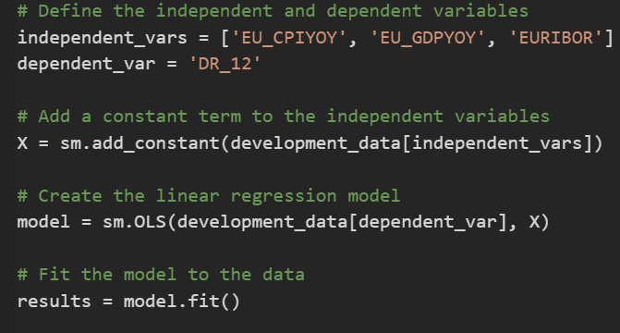
First model
A multiple linear regression model was built using the development dataset, with 'DR_12' as the dependent variable and 'EU_CPIYOY', 'EU_GDPYOY', and 'EURIBOR' as independent variables.

Slide 7
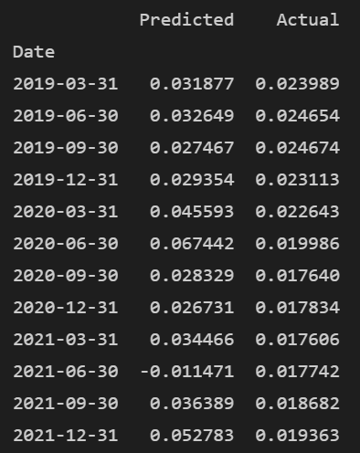
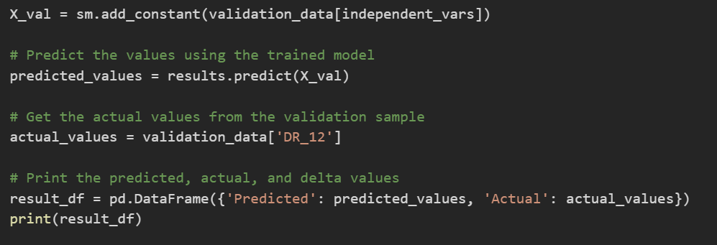
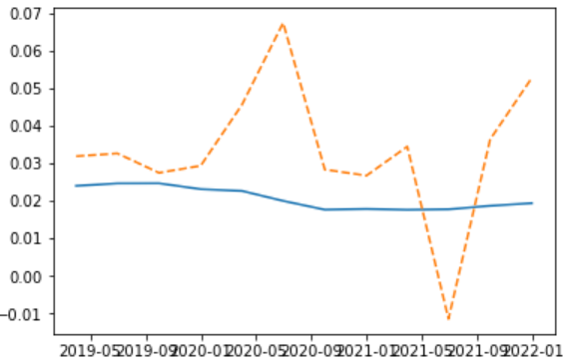
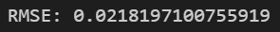
Predictions on validation set:
Actual vs Predicted (dotted)

Slide 8
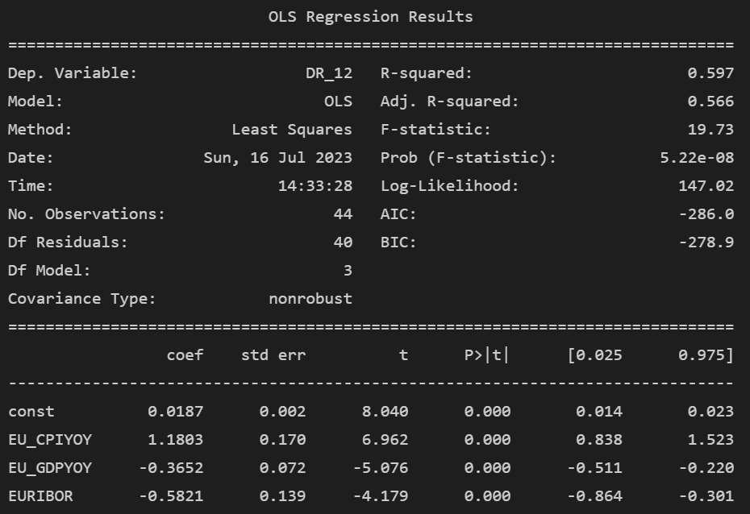
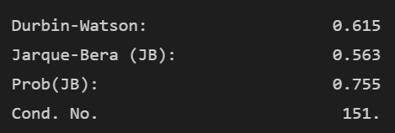
The R-squared value is 0.597, which suggests that around 59.7% of the variation in the dependent variable ('DR_12') can be explained by the independent variables. The p-values for the coefficients of 'EU_CPIYOY', 'EU_GDPYOY', and 'EURIBOR' are all less than 0.05, indicating that these variables are statistically significant in predicting 'DR_12
Autocorrelation test (failed)
Durbin-Watson (DW)
The DW statistic is 0.615, which indicates the presence of positive autocorrelation.

Slide 9
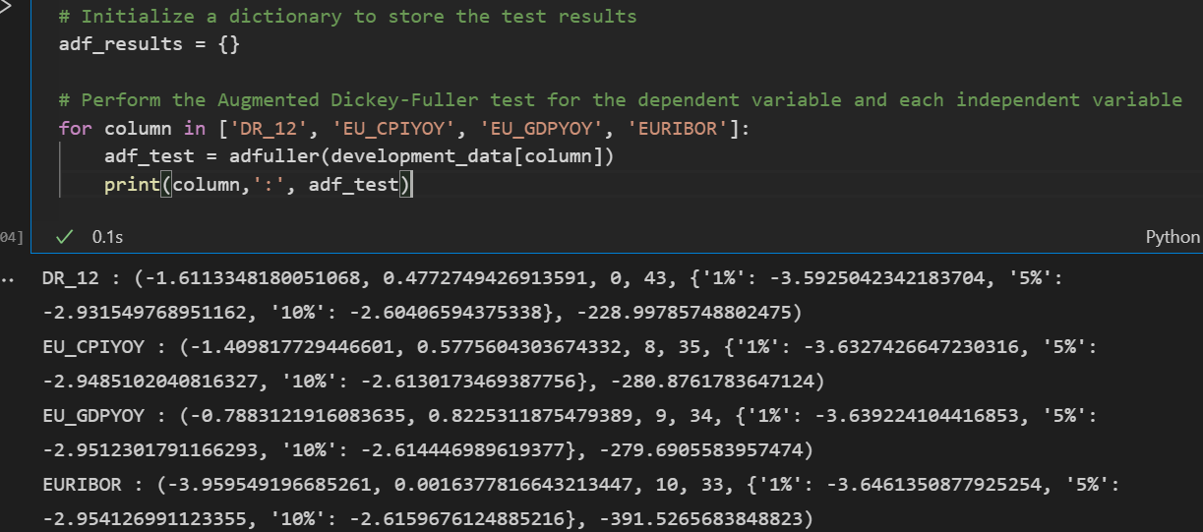
Stationarity test (failed)
Augmented Dickey-Fuller (ADF) The non-stationarity of 'DR_12', 'EU_CPIYOY', and 'EU_GDPYOY' could be a potential issue for our linear regression model, as it assumes that the data is stationary
'DR_12': The p-value is 0.48, which is greater than 0.05. We cannot reject the null hypothesis of the ADF test, implying that the 'DR_12' series is non-stationary.
'EU_CPIYOY': The p-value is 0.58, which is greater than 0.05. We cannot reject the null hypothesis of the ADF test, implying that the 'EU_CPIYOY' series is non-stationary.
'EU_GDPYOY': The p-value is 0.82, which is greater than 0.05. We cannot reject the null hypothesis of the ADF test, implying that the 'EU_GDPYOY' series is non-stationary.
'EURIBOR': The p-value is 0.0016, which is less than 0.05. We can reject the null hypothesis of the ADF test, implying that the 'EURIBOR' series is stationary.

Slide 10
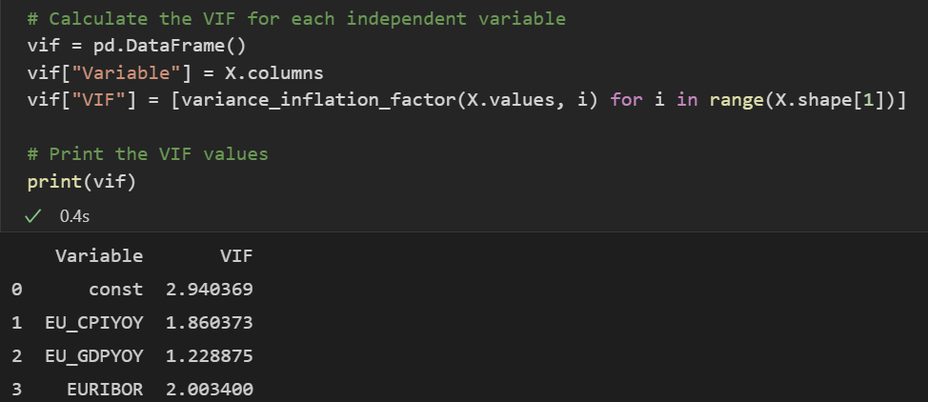
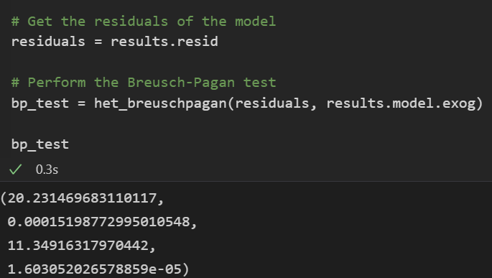
Multicollinearity test (passed)
Variance Inflation Factor Test (VIF) (passed)
All the VIFs are less than 10 (1.86 for 'EU_CPIYOY', 1.22 for 'EU_GDPYOY', and 2 for 'EURIBOR’). This suggests that there is no severe multicollinearity among the independent variables.
Heteroscedasticity test (passed)
Breusch Pagan
The p-value of the test is 0.00015, which is less than 0.05. This means we can reject the null hypothesis of the test, implying that the data is heteroscedastic (the error variances are not equal).

Slide 11
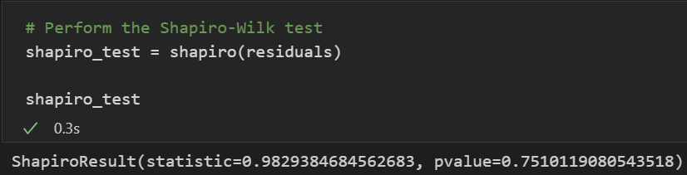
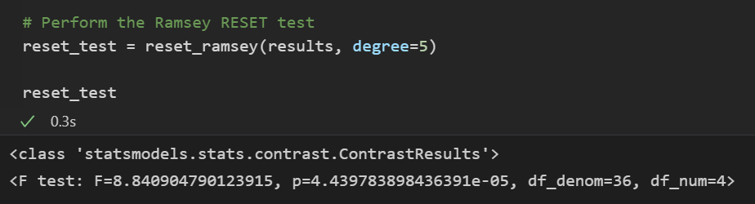
Normality of residuals (failed) Shapiro-Wilk
The p-value of the test is 0.75, which is greater than 0.05. This means we cannot reject the null hypothesis of the test, implying that the residuals are normally distributed.
Functional form test (failed)
Ramsey
The p-value of the test is 0.0000444, which is less than 0.05. This means we can reject the null hypothesis of the test, implying that the model might be misspecified. The diagnostic tests suggest that the model might have some issues.

Slide 12
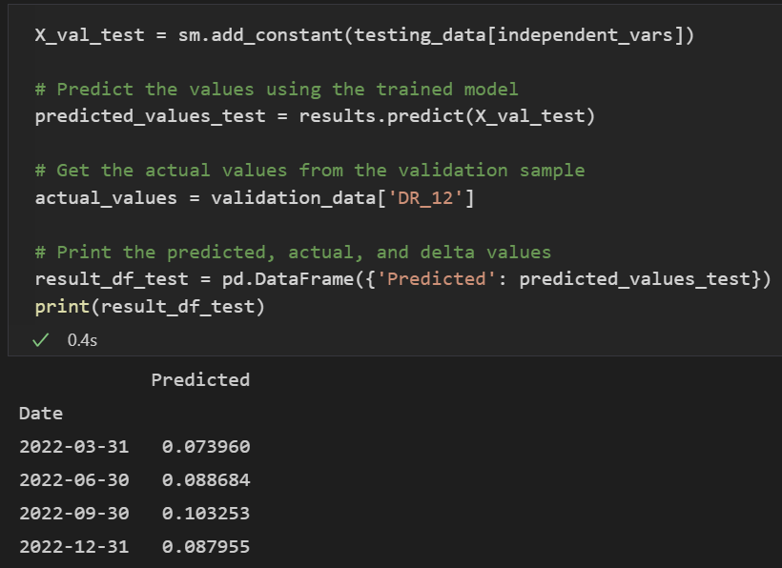
Predictions for testing sample
Predicted values for the test sample are:
Q1_2022: 0.073960
Q2_2022: 0.088684
Q3_2022: 0.103253
Q4_2022: 0.087955
Model’s performance is decent but has room for improvement.
The non-stationarity of some variables, the presence of heteroscedasticity, and the potential misspecification of the model could affect the model's predictive accuracy and the reliability of the standard errors and hypothesis tests. However, the multicollinearity tests and the normality test of residuals did not find any major issues.

Slide 13
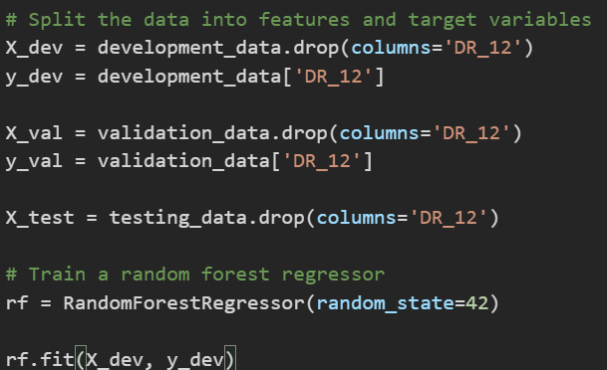
Second model
A random forest regressor was trained on the development data. The random forest model was chosen due to its ability to handle complex non-linear relationships between variables and its robustness to outliers and non-normal data. The development and validation sets were further split into features (X) and target variable (y).

Slide 14
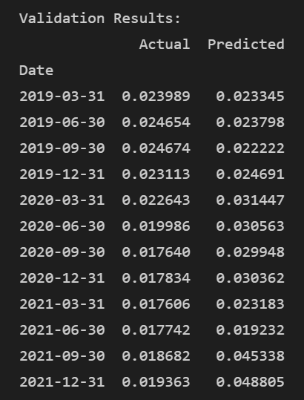
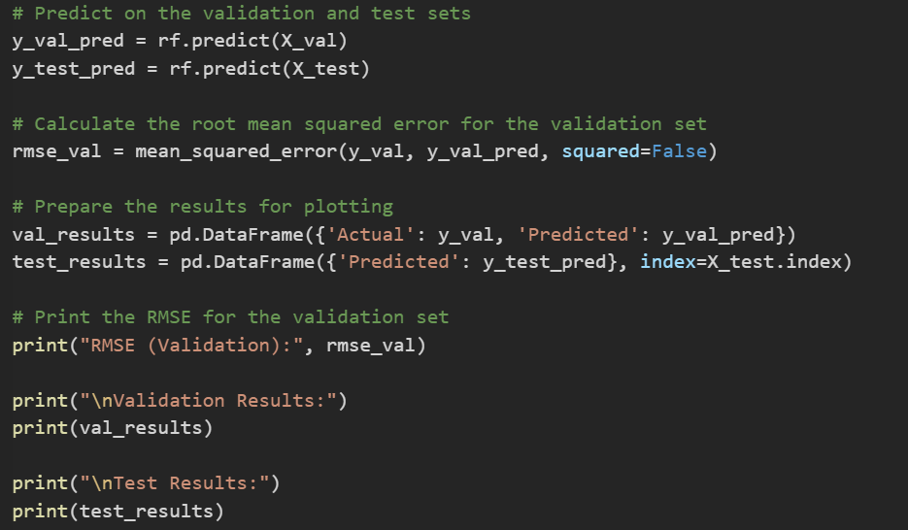
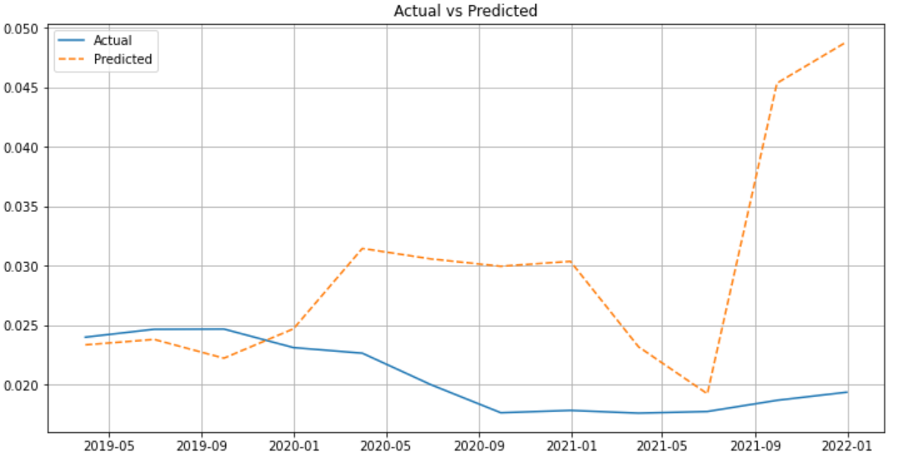

Slide 15
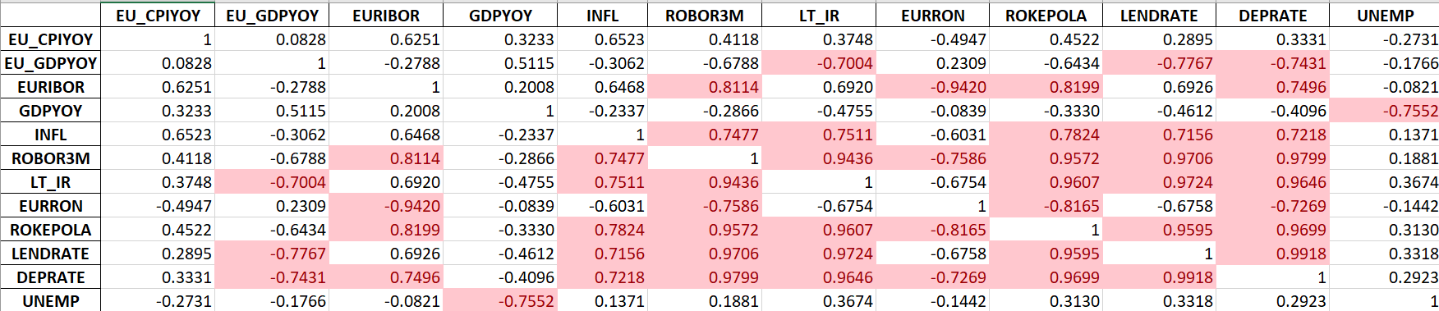
The correlation matrix shows the pairwise correlations between the independent variables.
We can see there are some highly correlated variable, However, it's worth noting that tree-based models such as random forests are generally less affected by multicollinearity compared to linear models, so I decided to keep it this way.
Random Forests are inherently robust to multicollinearity. This is because each tree in the Random Forest is built on a different subset of features, and the algorithm randomly selects a subset of features for each tree (which I consider a good enough built-in correction of correlation).

Slide 16
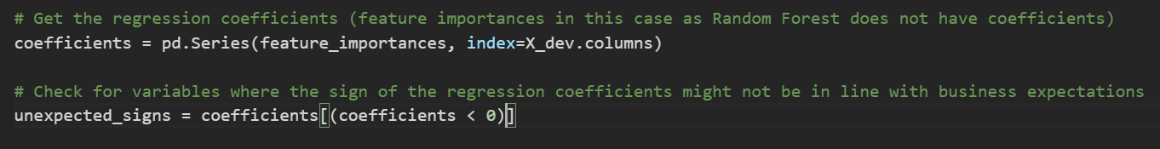
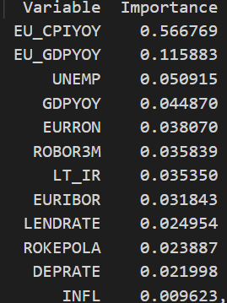
There are no variables where the sign of the regression coefficients might not be in line with business expectations (as we got no outputs for the code above), as all the feature importances (which serve as the equivalent of regression coefficients for the random forest model) are non-negative.
The feature importances were extracted from the random forest model. The 'EU_CPIYOY' variable was found to be the most important, followed by 'EU_GDPYOY', 'UNEMP', and 'GDPYOY'. No unexpected signs in the feature importances were detected. The importance of 'EU_CPIYOY' explains model’s incorrect predictions for Q3_2021 and Q4_2021.

Slide 17
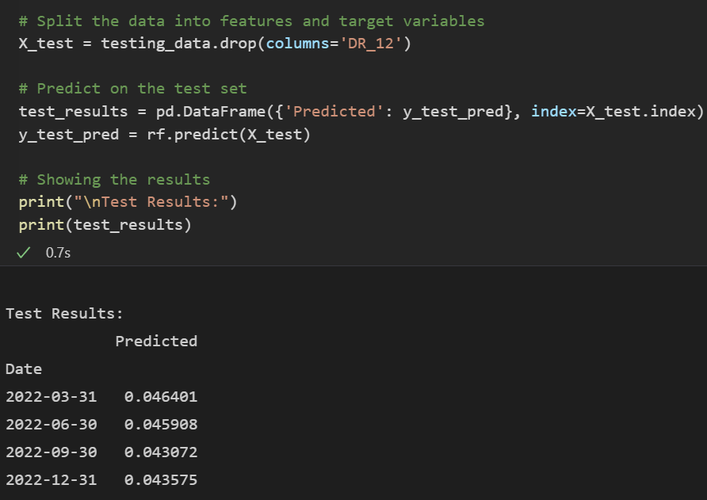
Predictions for testing sample
Predicted values for the test sample are:
Q1_2022: 0.046401
Q2_2022: 0.045908
Q3_2022: 0.043072
Q4_2022: 0.043575
The random forest model performed well on the validation data, as evidenced by the low RMSE and the closeness of the actual versus predicted plots. While there were several pairs of highly correlated independent variables, this did not appear to negatively affect the model's overall predictive power.
A random forest model could be a useful tool for predicting the default rate of a bank portfolio based on macroeconomic factors.

Slide 18
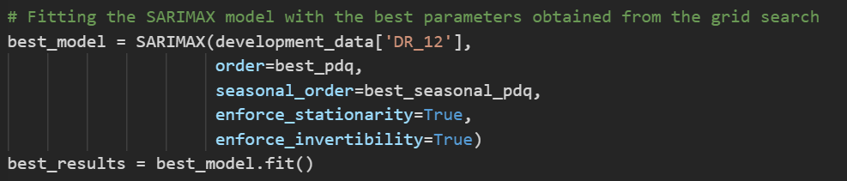
Third model
The SARIMAX (Seasonal AutoRegressive Integrated Moving Average with eXogenous regressors) model was used due to its ability to model seasonal data, which is suitable for our quarterly data.
The SARIMAX model parameters were selected using a grid search approach on the development sample.

Slide 19
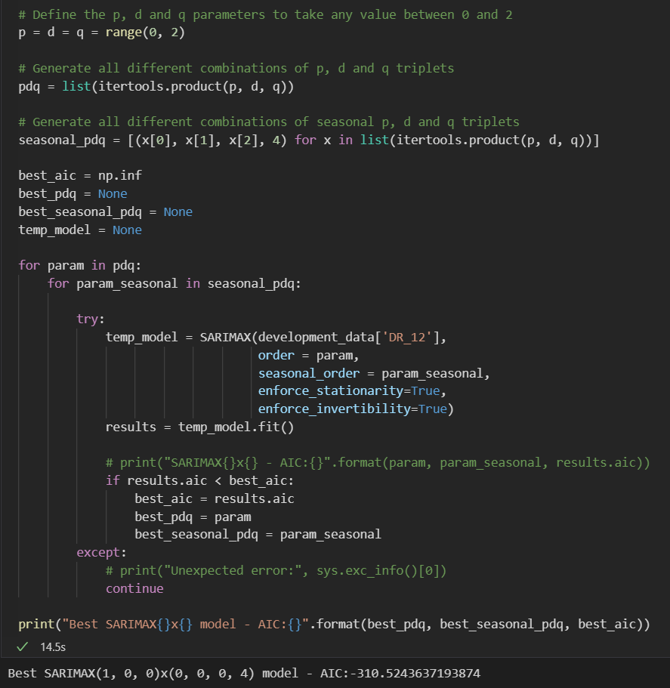
The parameters for the SARIMAX model were determined by a grid search approach. The grid search found the best parameters to be p=1, d=0, q=0 for the non-seasonal components, and P=0, D=0, Q=0, S=4 for the seasonal components.
This model had the lowest Akaike Information Criterion (AIC) value of -310.524.
The model was then fitted using these parameters on the development sample.

Slide 20
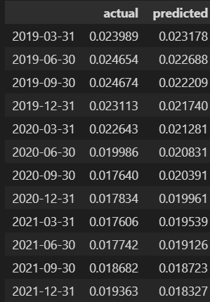
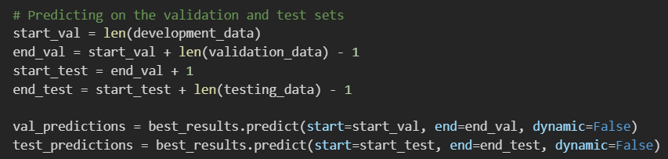
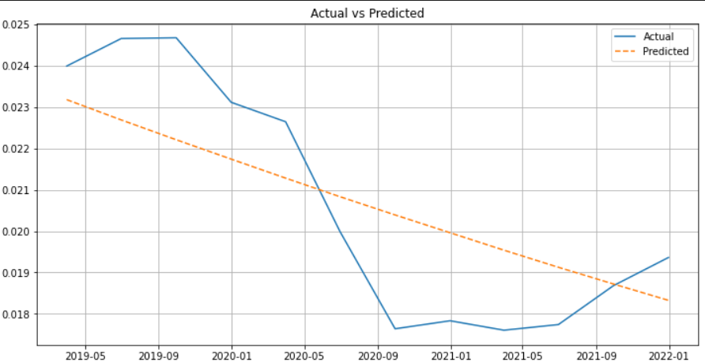

Slide 21
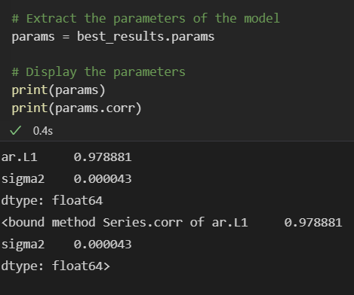
The fitted SARIMAX model is a univariate model, meaning it only uses past values of the target variable ('DR_12') to make predictions. Therefore, it does not provide coefficients for other variables like GDP or inflation.
ar.L1 (AutoRegressive term of order 1)
sigma2: (Variance of the error term)
They have a correlation of 0.000043 which is significantly lower than the specified threshold of 70%, and the signs are also in line with business expectations

Slide 22
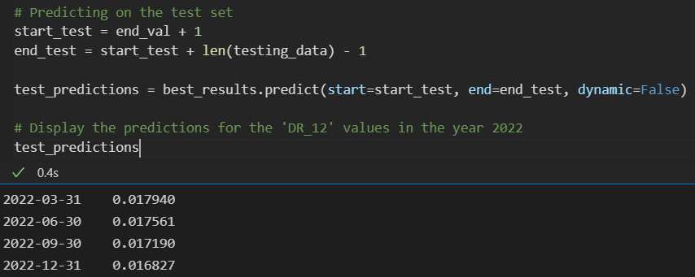
Predictions for testing sample
Predicted values for the test sample are:
Q1_2022: 0.017940
Q2_2022: 0.017561
Q3_2022: 0.017190
Q4_2022: 0.016827
The SARIMAX model was successfully used to predict 'DR_12' on the validation and test samples. It also has the best RMSE (by far) out of all and the most accurate plot.
Therefore, SARIMAX is selected as the final model.

Slide 23

Sorry for the long monologue,
here’s a cookie :)

